Slide 3
Perfect Mom

Slide 4
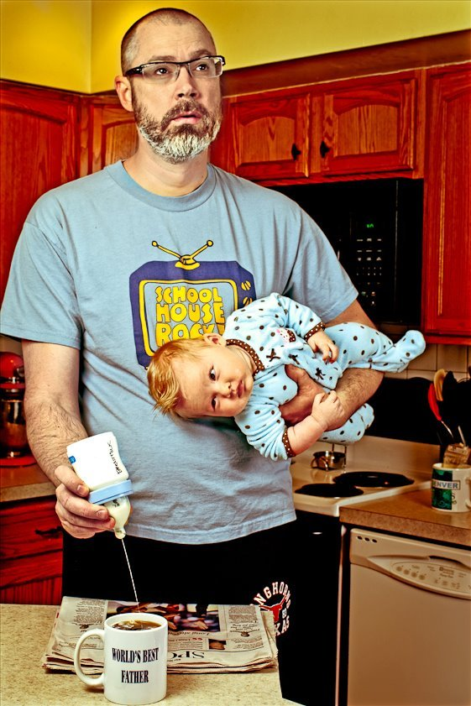
Not so Perfect Dad

Slide 5
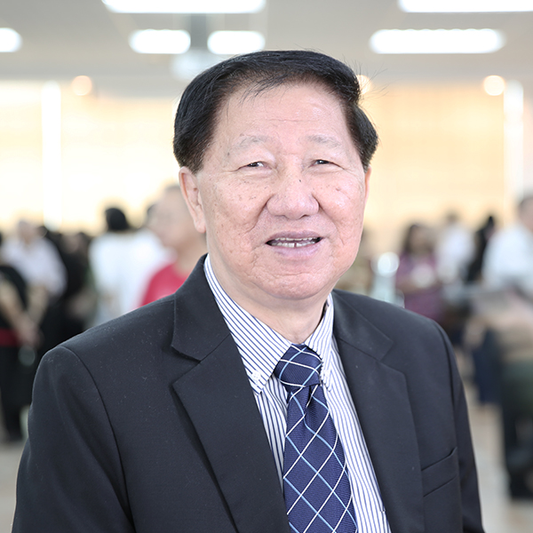
Perfect Dad?
Ps Tay Cheng Kee

Slide 6
Outline
1. The Burden of Parenting
2. Faithfulness Not Perfection
3. More than Mentors

Slide 7
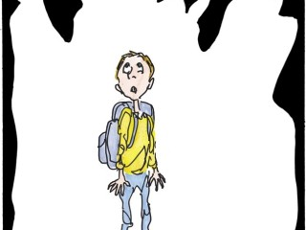
1. The Burden of Parenting
A. The busyness of life
B. The child trap
C. The fear of failure

Slide 8
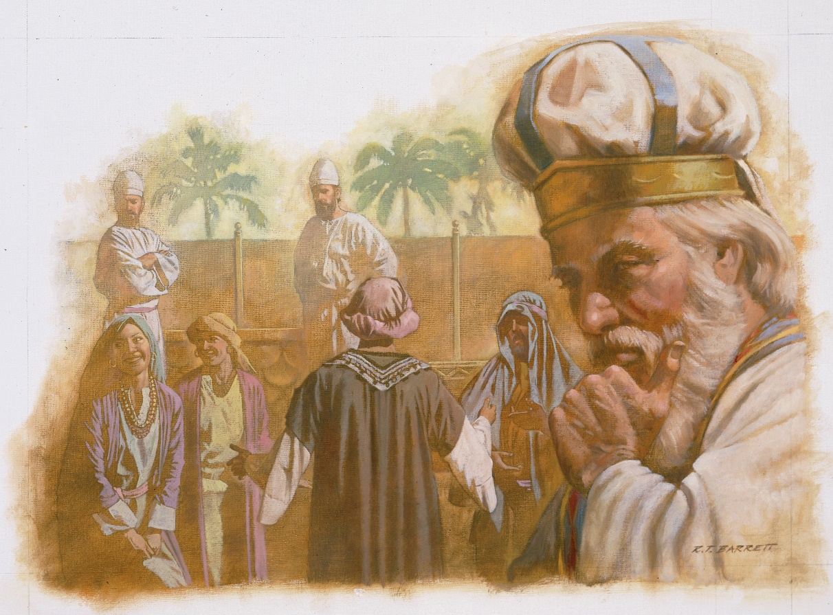
Examples of failed parents:
(1) Eli
1 Samuel 2:22-25
22 Now Eli, who was very old, heard about everything
his sons were doing to all Israel and how they slept with the women who served at the entrance to the tent of meeting. 23 So he said to them, “Why do you do such things? I hear from all the people about these wicked deeds of yours. 24 No, my sons; the report I hear spreading among the Lord’s people is not good. 25 If one person sins against another, God may mediate for the offender; but if anyone sins against the Lord, who will intercede for them?” His sons, however, did not listen to their father’s rebuke, for it was the Lord’s will to put them to death.

Slide 9
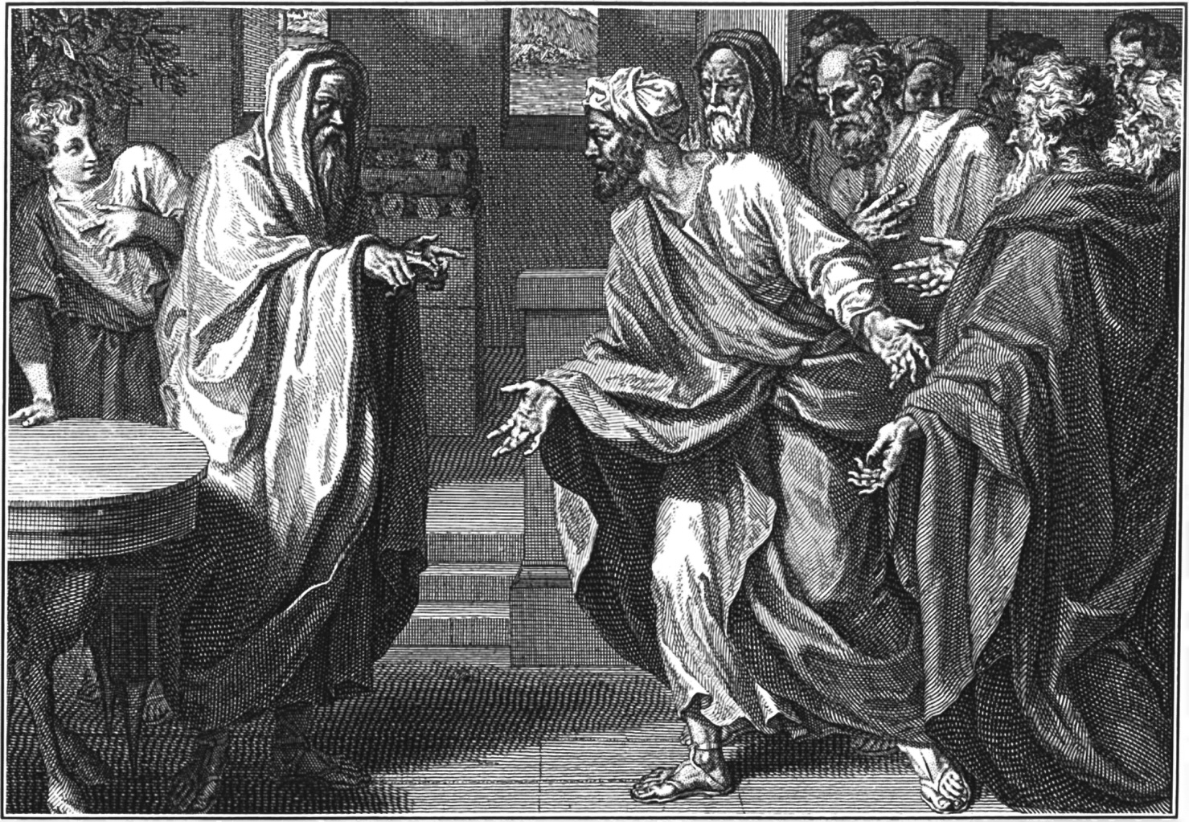
Examples of failed parents:
(2) Samuel
1 Samuel 8:3 But his sons did not
follow his ways. They turned aside
after dishonest gain and accepted
bribes and perverted justice.

Slide 10
X
2. Faithfulness Not Perfection
Am I parenting faithfully?
Am I parenting perfectly?

Slide 11
Example of Ezekiel
Ezekiel 3:4-11
4 He then said to me: “Son of man, go now to the people of Israel and speak my words to them.
5 You are not being sent to a people of obscure speech and strange language, but to the people of Israel— 6 not to many peoples of obscure speech and strange language, whose words you cannot understand. Surely if I had sent you to them, they would have listened to you. 7 But the people of Israel are not willing to listen to you because they are not willing to listen to me, for all the Israelites are hardened and obstinate. 8 But I will make you as unyielding and hardened as they are. 9 I will make your forehead like the hardest stone, harder than flint. Do not be afraid of them or terrified by them, though they are a rebellious people.” 10 And he said to me, “Son of man, listen carefully and take to heart all the words I speak to you. 11 Go now to your people in exile and speak to them. Say to them, ‘This is what the Sovereign Lord says,’ whether they listen
or fail to listen.”

Slide 12
Example of Ezekiel [Ezekiel 3:4-11]
It was uphill at the beginning.
But God made him stronger.

Slide 13
The Special Place of Faith in the Family
Acts 16:31 They replied, “Believe in the Lord Jesus, and you will be saved—you and your household.”
Genesis 7:1 The Lord then said to Noah, “Go into the ark, you and your whole family, because I have found you righteous in this generation.
Exodus 12:13 The blood will be a sign for you on the houses where you are, and when I see the blood, I will pass over you. No destructive plague will touch you when I strike Egypt.

Slide 14
Video

Slide 15
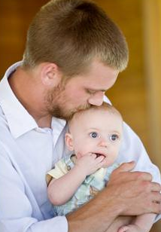
3. More than Mentors
A parent blesses
Genesis 1:27-28a
27 So God created mankind in his own image, in the image of God he created them; male and female he created them. 28 God blessed them …

Slide 16
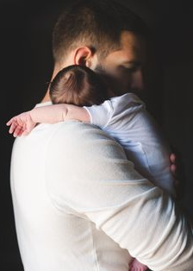
3. More than Mentors
A parent loves and protects
James 1:27 Religion that God our Father accepts as pure and faultless is this: to look after orphans and widows in their distress and to keep oneself from being polluted by the world.

Slide 17
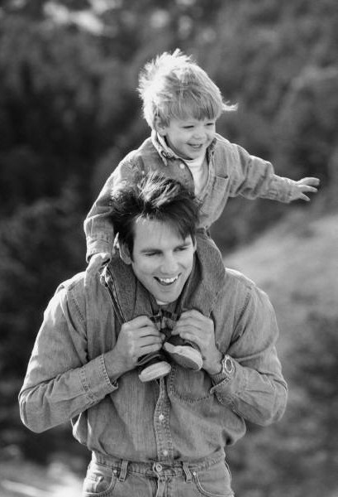
With his children
1 Thessalonians 2:11-12
11 For you know that we dealt with each of you
as a father deals with his own children, 12 encouraging, comforting and urging you to live lives worthy of God, who calls you into his kingdom and glory.
Deuteronomy 1:31 and in the wilderness. There you saw how the Lord your God carried you, as a father carries his son, all the way you went until you reached this place.

Slide 18
3. More than Mentors
A parent teaches the children about God
Deuteronomy 6:6-7
6 These commandments that I give you today are to be on your hearts. 7 Impress them on your children. Talk about them when you sit at home and when you walk along the road, when you lie down and when you get up.

Slide 19
The Children’s Perspective
Ephesians 6:1 Children, obey your parents in the Lord, for this is right.
Remember, It is tough being a parent, a provider, a guardian, the house cheerleader, the cockroach exterminator, the educationist, the mediator, the security guard etc.

Slide 20
The Children’s Perspective
Your Parents the Pilot
Teamwork
Dependability
Authority
Expertise

Slide 21
The Children’s Perspective
Proverbs 13:1 A wise son heeds his father’s instruction, but a mocker does not respond to rebukes.

Slide 22
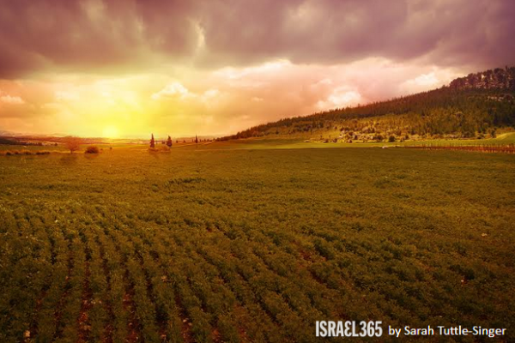
CONCLUSION
Deuteronomy 6:11-12
10 So it shall be, when the Lord your God brings you into the land of which He swore to your fathers, to Abraham, Isaac, and Jacob, to give you large and beautiful cities which you did not build, 11 houses filled with all kinds of good things you did not provide, wells you did not dig, and vineyards and olive groves you did not plant—then when you eat and are satisfied, 12 be careful that you do not forget the Lord, who brought you out of Egypt, out of the land of slavery.

Slide 23
CONCLUSION
Point your family back to God.
Do not try to be the perfect parent but do make it your goal to be a faithful one.
Now is the time to do it!

